Slide 1
Raspberry Pi and GPIO
Giuseppe Scanniello
Simone Romano
Michelangelo Esposito

Slide 2
General information
A general purpose development board, much like Arduino.
Available in different models, with increase functionalities.
Raspbian OS based on Linux, stored on a micro SD card.
Programmable in Python, MicroPython or C++.
Top models (i.e. Raspberry Pi 4B) are effectively mini computers.
Mouse/keyboard support
HMDI Display output
Up to 8GB RAM.

Slide 3
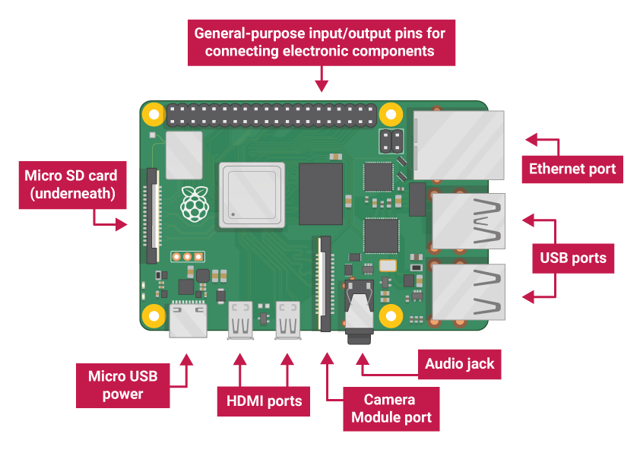
General information

Slide 4
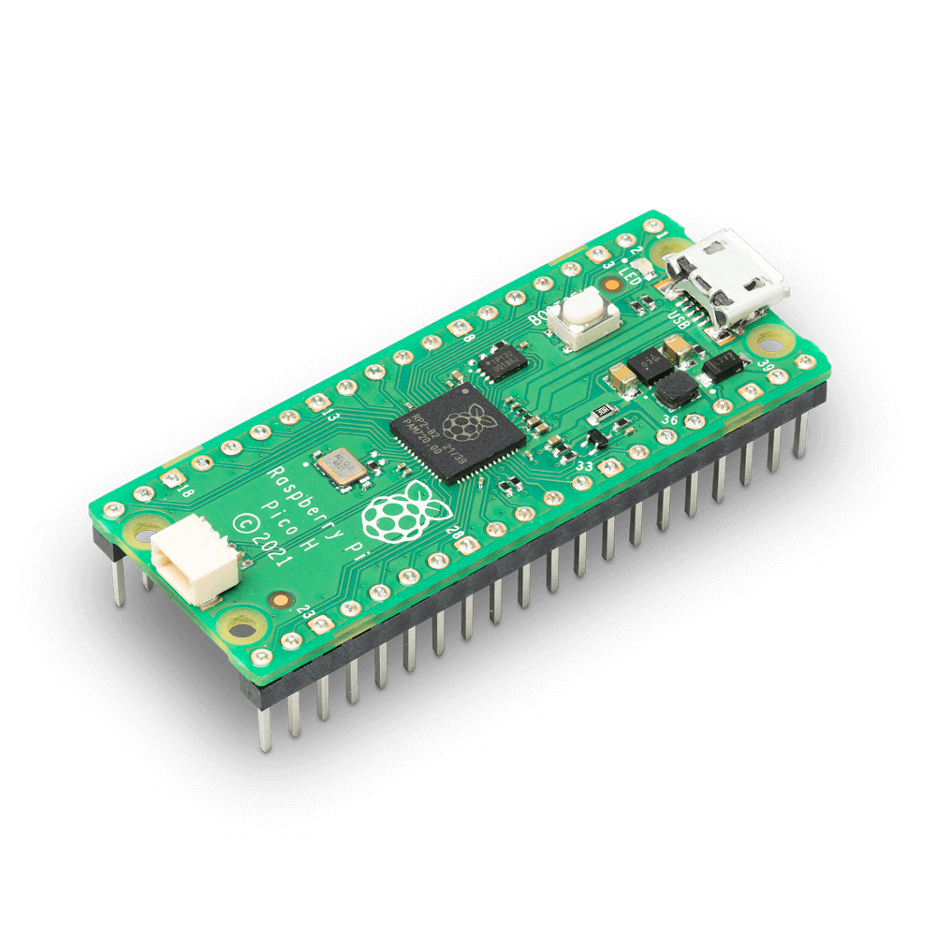
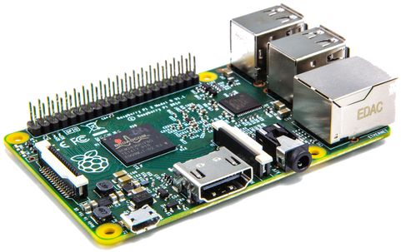
Two of the models
Raspberry Pi 4
Raspberry Pi Pico

Slide 5
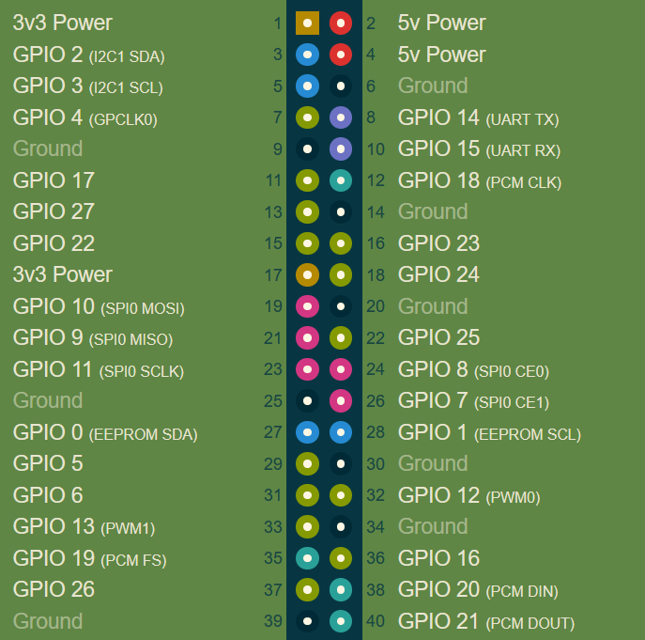
Raspberry Pi pinout
Model-independent
Power pins (2, 4, 17)
Ground pins (6, 9, 25, …)
GPIO pins (3, 5, 7, …)

Slide 6
General Purpose Input-Output
Uncommitted digital signal pins which may be used as inputs or outputs and are controllable via software.
Most commonly used as a mean of communication with other hardware (i.e. sensors and actuators)

Slide 7
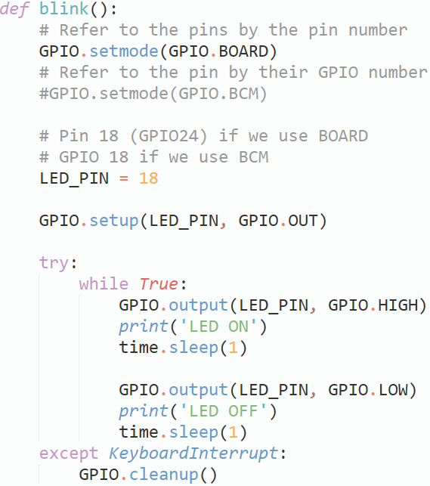
General Purpose Input-Output
Setting the pin mode
Setting LED_PIN as an output pin
Turn on the LED
Turn off the LED

Slide 8
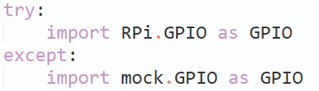
A (mocked) GPIO library
How can we use the GPIO functionalities without the actual board?
Create a mocked implementation. Then, based on hardware availability either import the mock or the real one.

Slide 9
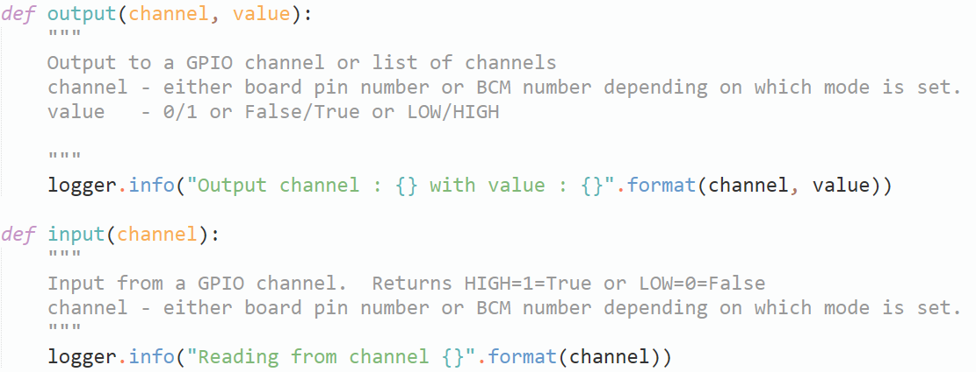
A (mocked) GPIO library
Library credits to https://github.com/codenio/Mock.GPIO

Slide 10
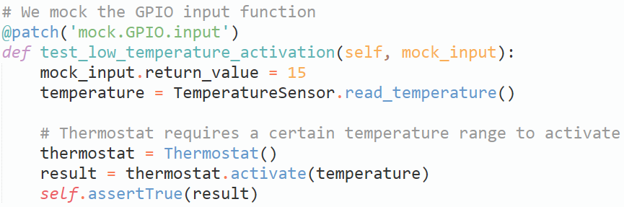
A (mocked) GPIO library

